Slide 1



Data
Culture
Society
We support, facilitate, promote and inspire data-led and applied digital research across the arts, humanities and social sciences.
@edCDCS
Notes:
MT

Slide 2
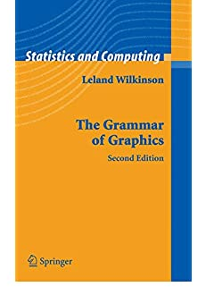

The grammar of Graphics
Sentences are elegant compositions of carefully chosen grammatical elements that convey precise and clear messages
Visualisations are elegant mapping of data onto the right visual encondings to tell a story
By Leland Wilkinson
www.cdcs.ed.ac.uk

Slide 3
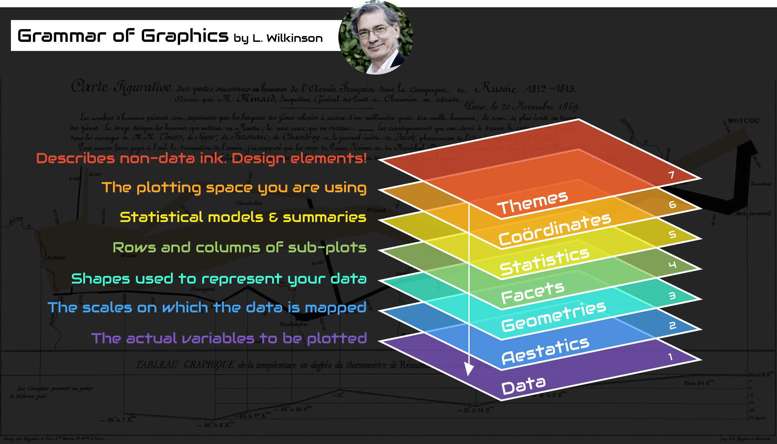
www.cdcs.ed.ac.uk

Slide 4
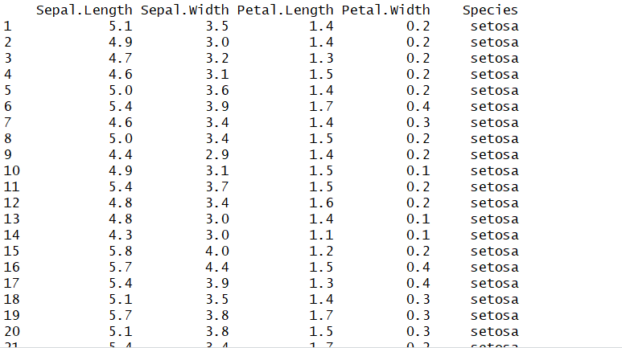
The data
Level 1: The Dataset I am using
If I want to plot the same type of chart with different data all you have to change is the data reference in the code
www.cdcs.ed.ac.uk

Slide 5
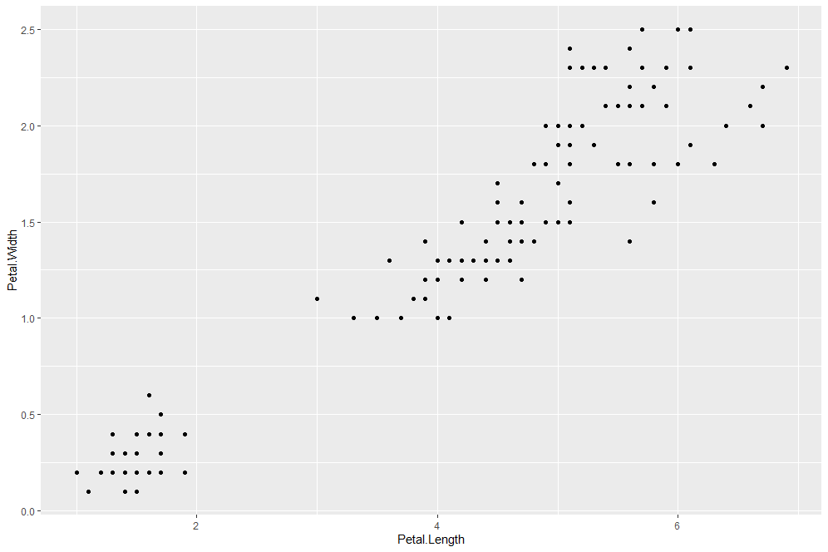
Aesthetic and geometries
Level 2 and 3
Aesthetics identify which variables I want to work on (depending on the type of chart you are going to work on one or more variables)
Geometries identify the type of chart that I want to produce.
ggplot(iris, aes(x=Petal.Length, y=Petal.Width)) + geom_point()
www.cdcs.ed.ac.uk

Slide 6
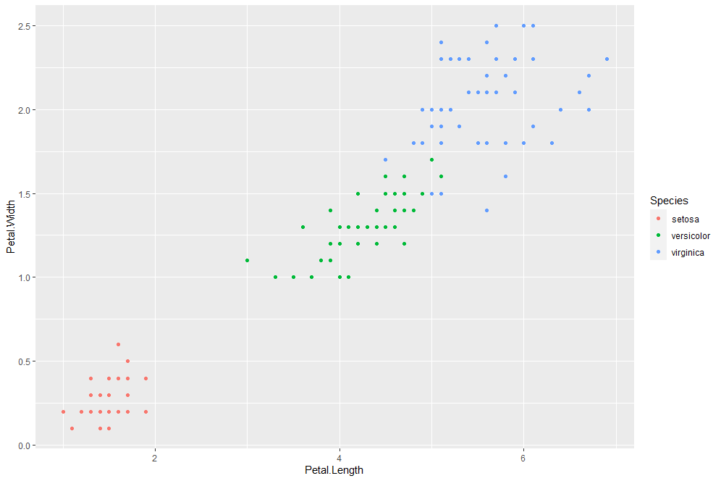
aesthetic
Level 2
Aesthetics Add a third colour coded variable. Since it is still linked to the aesthetics I need to set it within that part of the code
ggplot(iris, aes(x=Petal.Length, y=Petal.Width, color=Species)) + geom_point()
www.cdcs.ed.ac.uk

Slide 7
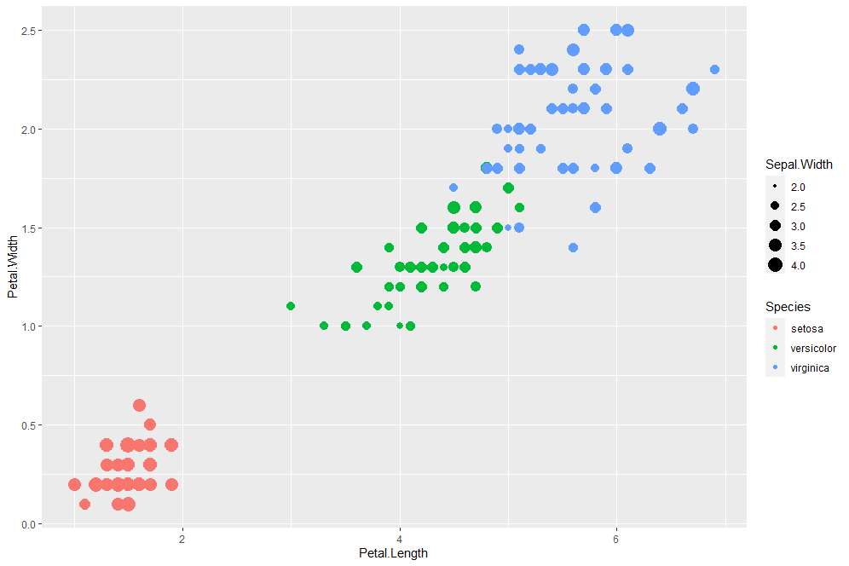
aesthetic
Level 2
Aesthetics Add a fourth size coded variable. Since it is still linked to the aesthetics I need to set it within that part of the code
ggplot(iris, aes(x=Petal.Length, y=Petal.Width, color=Species, size=Sepal.Width)) + geom_point()
www.cdcs.ed.ac.uk

Slide 8
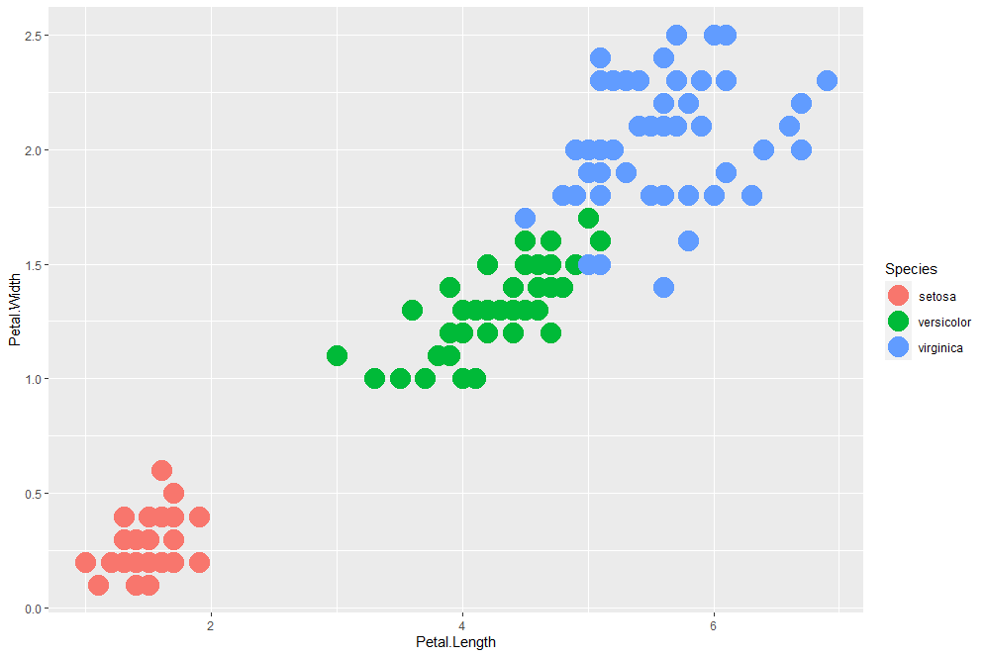
GEometry
Level 3
Geometry. If I just want all the dots to be bigger I shall set the value in the geometry part of the code.
ggplot(iris, aes(x=Petal.Length, y=Petal.Width, color=Species)) + geom_point(size=7)
www.cdcs.ed.ac.uk

Slide 9
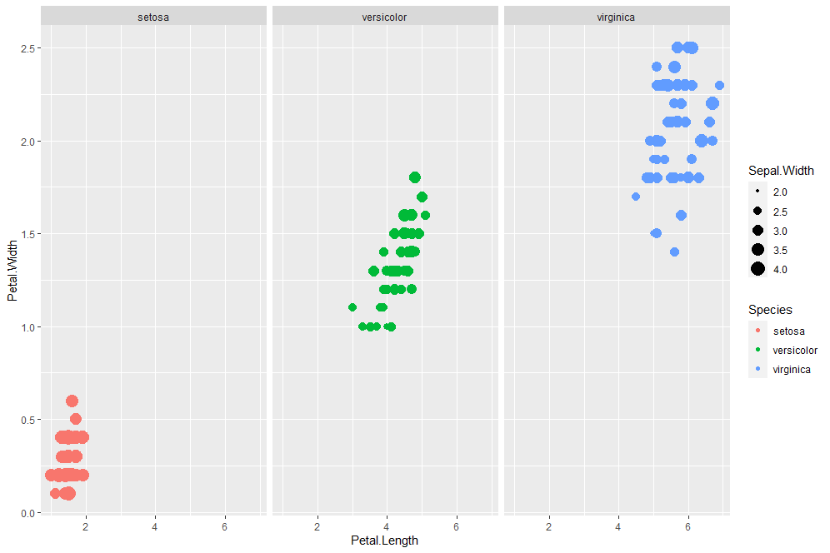
facet
Level 4 Subplot
Facet. If I just want to visualise the results on separate subplot you need to add this new level of information
ggplot(iris, aes(x=Petal.Length, y=Petal.Width, color=Species, size=Sepal.Width)) + geom_point()+facet_wrap(~Species)
www.cdcs.ed.ac.uk

Slide 10
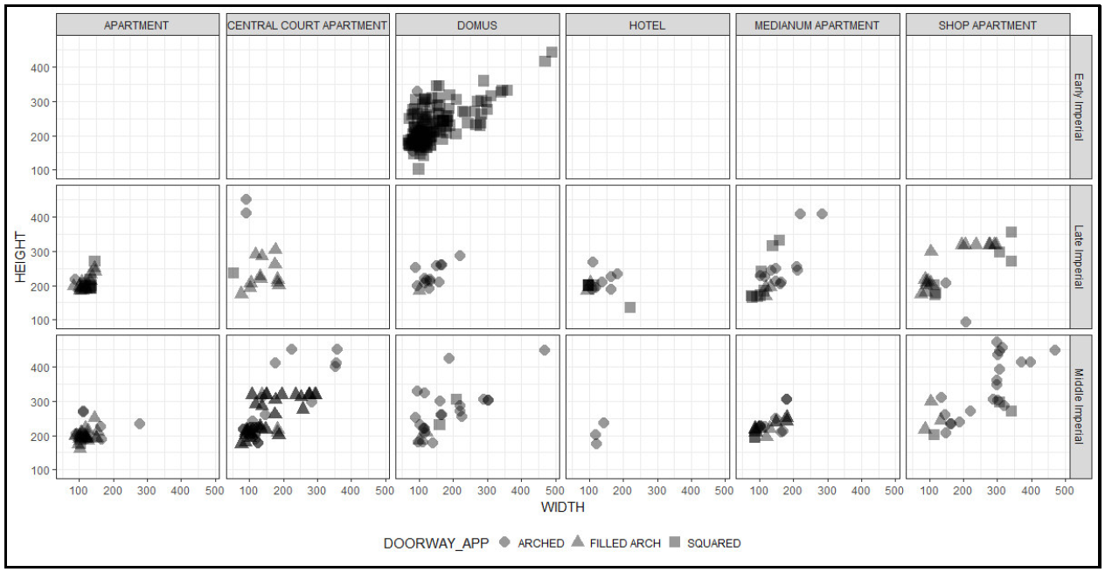
facet
Level 4 Subplot
Facet. If I just want to visualise the results on separate subplot you need to add this new level of information
If you want to subplot across 2 different variables use facet_grid
ggplot(iris, aes(x=Petal.Length, y=Petal.Width, color=Species, sizcie=Sepal.Width)) + geom_point()+facet_grid(Petal.Width~Spees)
www.cdcs.ed.ac.uk

Slide 11
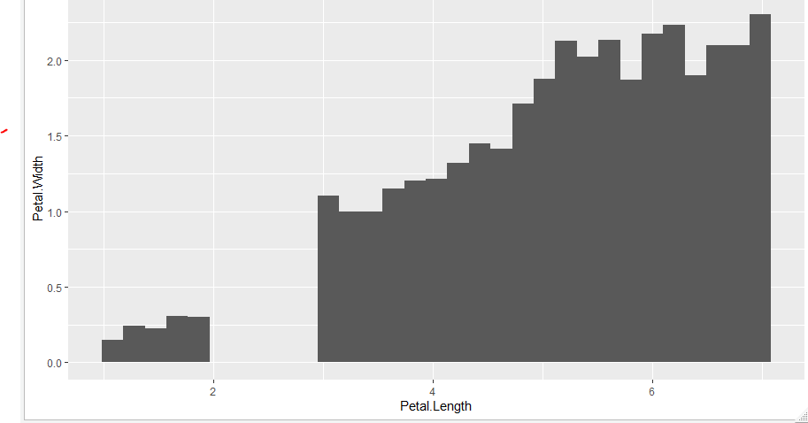
statistics
Level 5 Summarizing Stats
Instead of the data if you want to plot the summarising of those data you do so using the stats level
ggplot(iris, aes(x=Petal.Length, y=Petal.Width)) + stat_summary_bin(fun.y="mean", geom = "bar")
www.cdcs.ed.ac.uk

Slide 12
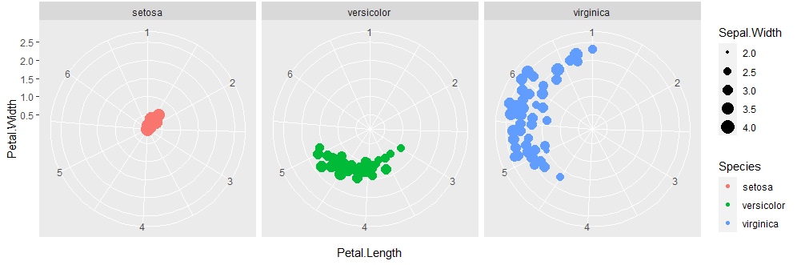
coordinates
Level 6 Coordinates
On this level you can set the attributes of the coordinates, change the scale or transform in polar
ggplot(iris, aes(x=Petal.Length, y=Petal.Width, color=Species, size=Sepal.Width)) + geom_point()+facet_wrap(~Species)+coord_polar()
www.cdcs.ed.ac.uk

Slide 13
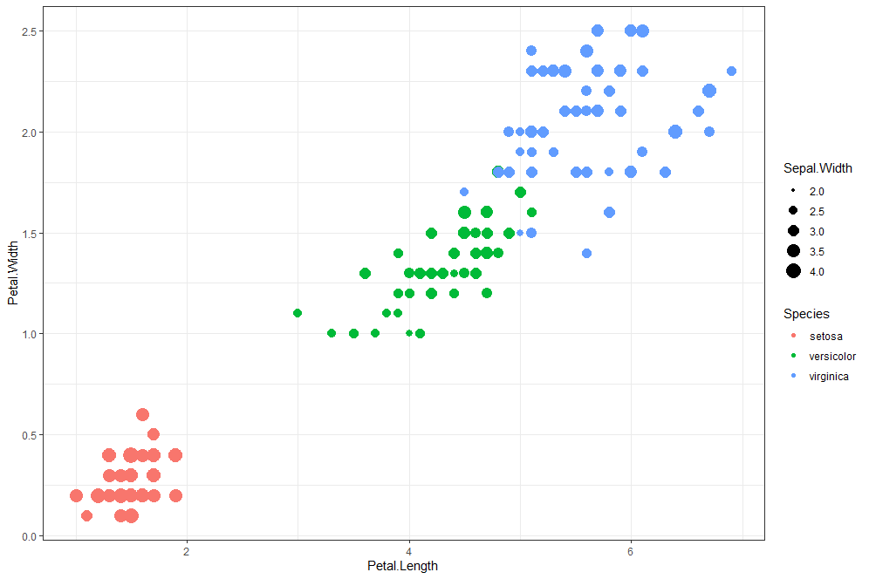
themes
Level 7 Global settings
Global settings of the charts can be changed in the theme part of the code. All non data ink
ggplot(iris, aes(x=Petal.Length, y=Petal.Width, color=Species, size=Sepal.Width)) + geom_point()+theme_bw()
www.cdcs.ed.ac.uk

Slide 14
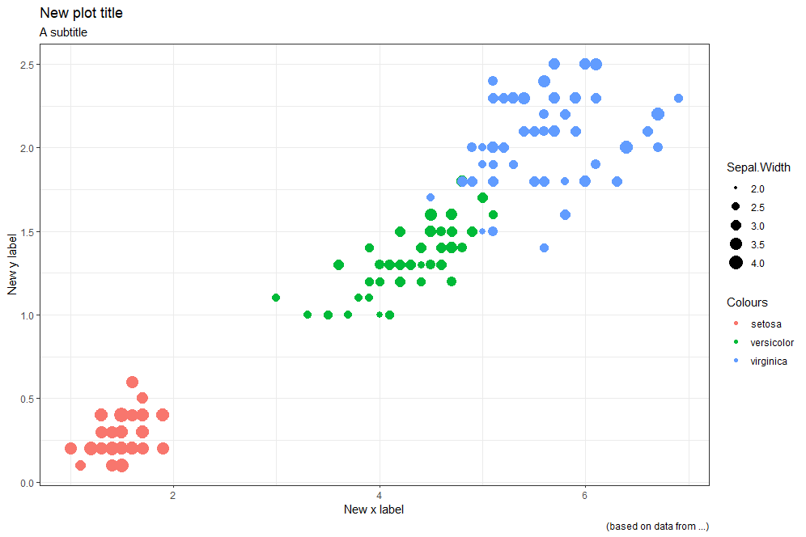
labels
Level 7 labels
A peculiar setting you want to pay attention to are the lables
ggplot(iris, aes(x=Petal.Length, y=Petal.Width, color=Species, size=Sepal.Width)) + geom_point()+theme_bw() + labs(title = "New plot title", subtitle = "A subtitle", caption = "(based on data from ...)", x = "New x label", y= "New y label", color = "Colours")
www.cdcs.ed.ac.uk

Slide 15
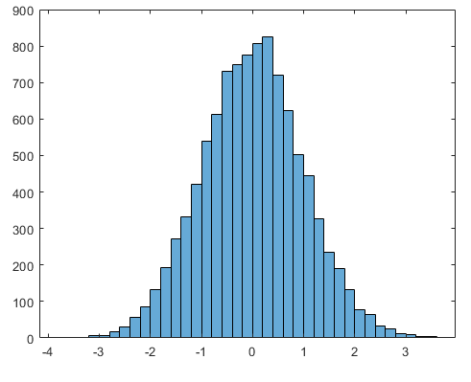
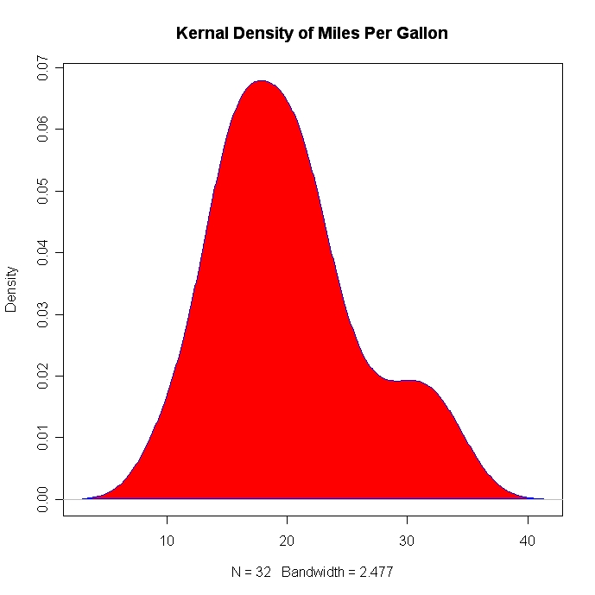
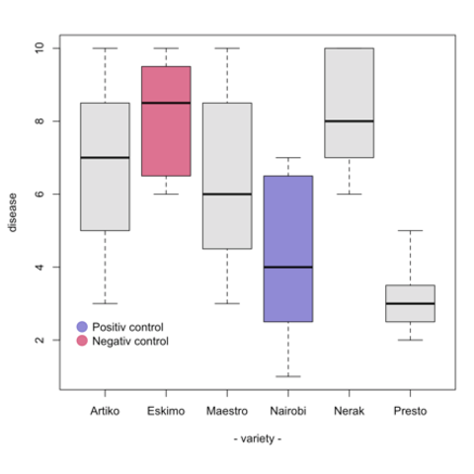
distribution
Histogram
Density Plot
Boxplot
www.cdcs.ed.ac.uk

Slide 16
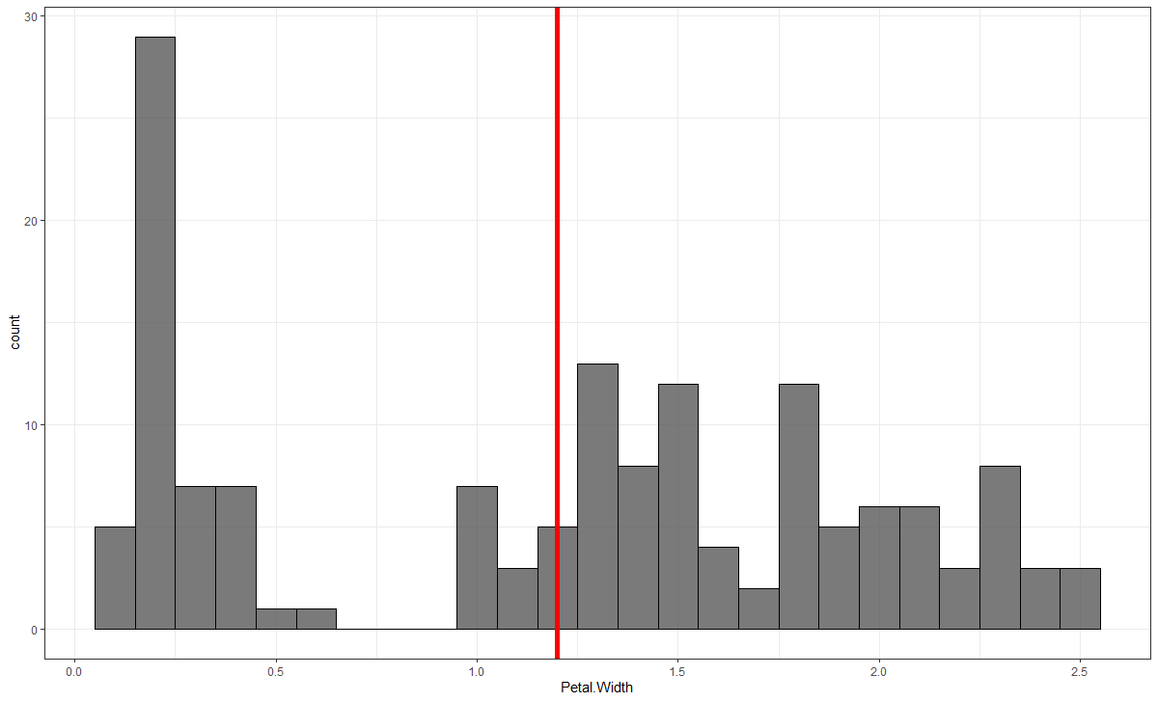
Visualise the distribution: Histogram and Density plots
A histogram is an approximate representation of the distribution of numerical or categorical data.
geom_histogram
www.cdcs.ed.ac.uk

Slide 17
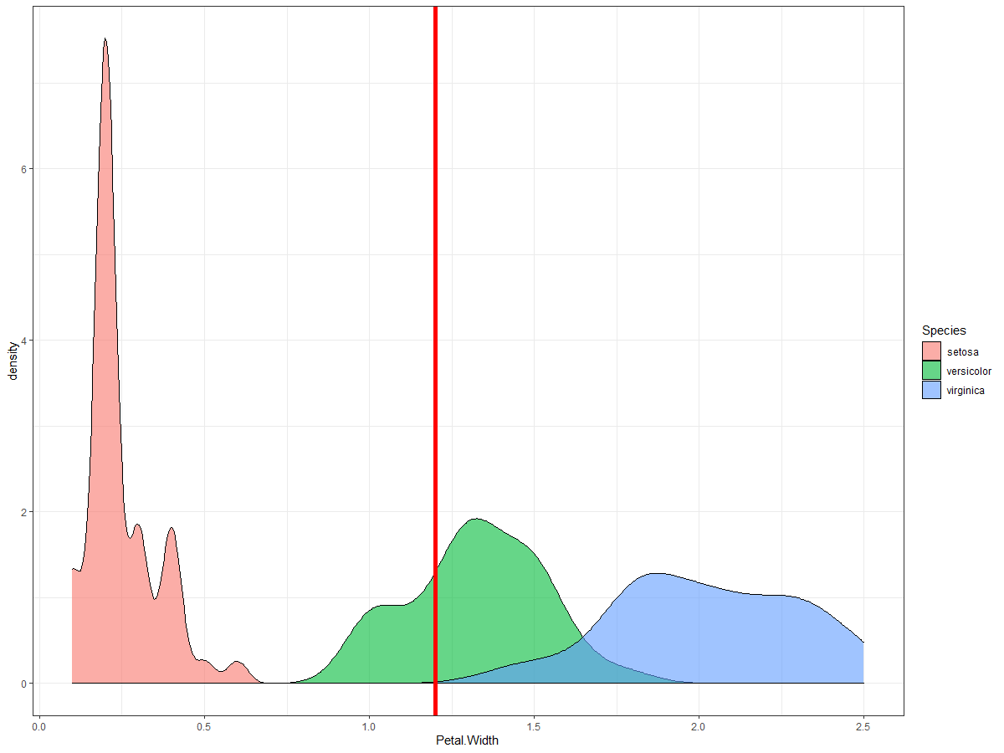
Visualise the distribution: Histogram and Density plots
A density plot is a representation of the distribution of a numeric variable. It uses a kernel density estimate to show the probability density function of the variable. It is a smoothed version of the histogram and is used in the same concept.
geom_density
www.cdcs.ed.ac.uk

Slide 18
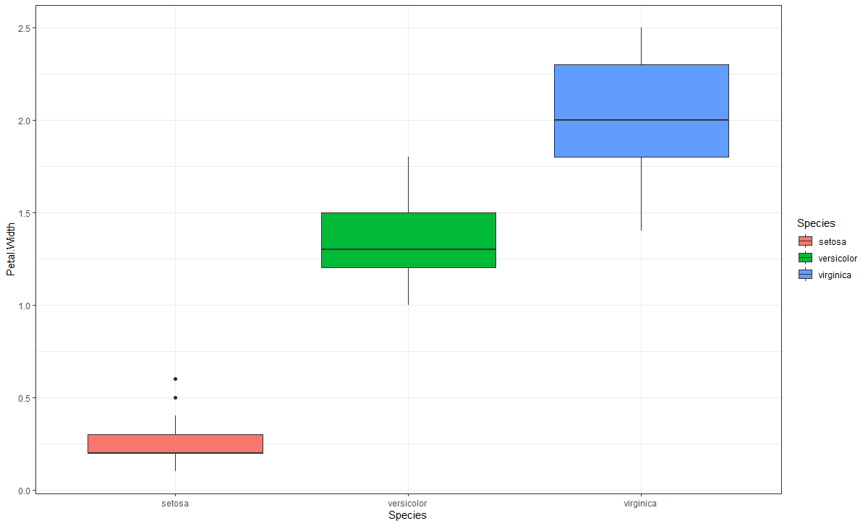
BOXPlots
The thick black line is the median.
The boxes represent 50% of the sample closest to the median
The whiskers correspond to 95% of the sample closest to the median aka 2SD from the median
The dots represent the outliers
www.cdcs.ed.ac.uk

Slide 19
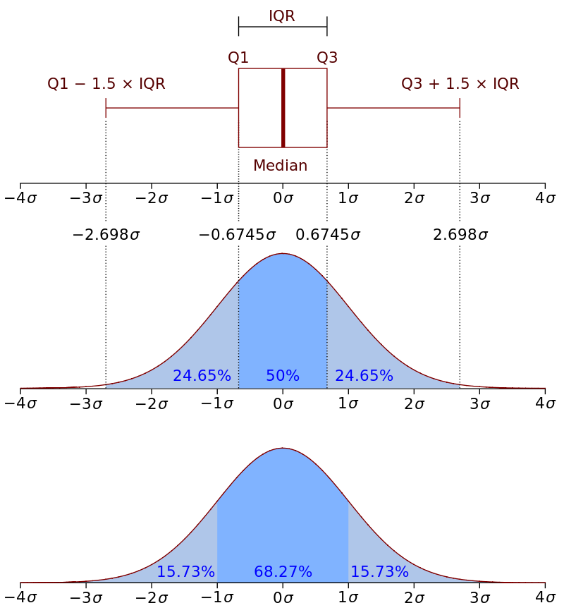
boxplot
The outliers are all the value below or above 1.5* the interquartile range from Q1 and Q3
By adding a + geom_jitter(size= 4, alpha =0.3) you can add the information of the single observations
You cand add the mean information by create a means dataframe using the aggregate command And then use stat_summary and geom_text commands
www.cdcs.ed.ac.uk

Slide 20
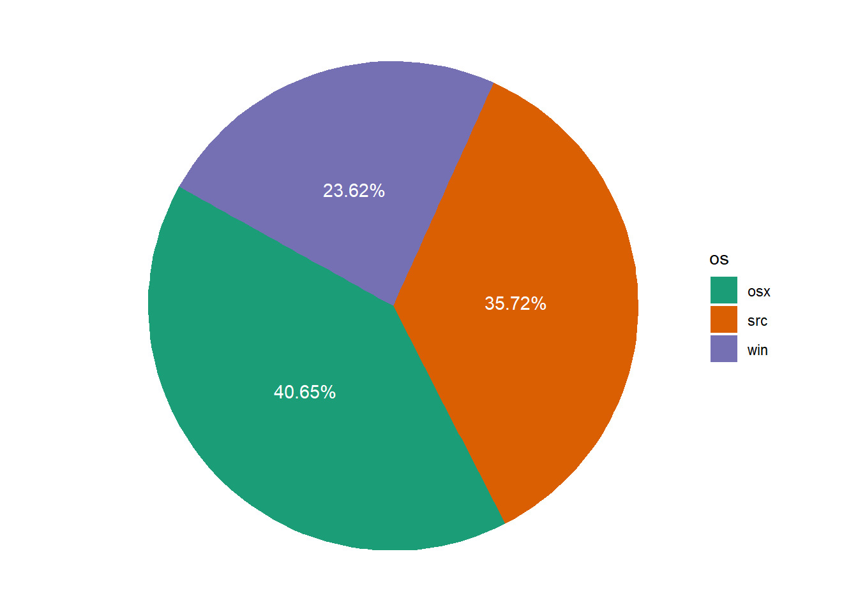
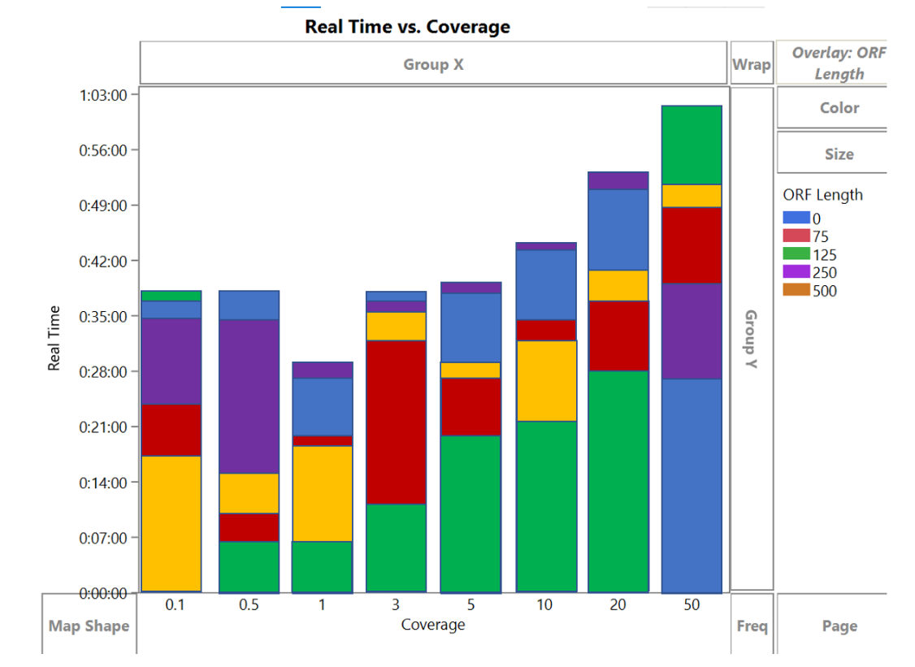
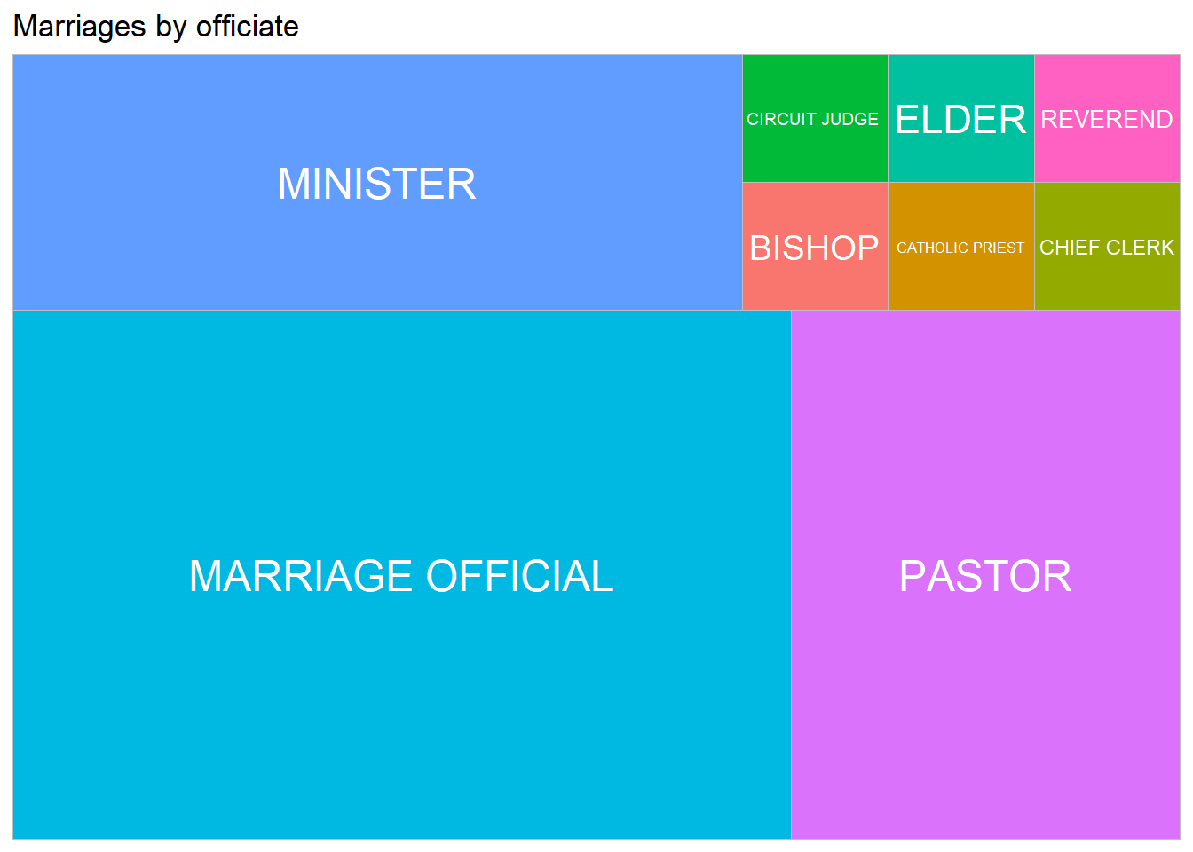
RATIO
Piechart
Stacked bar graph
Treemap
www.cdcs.ed.ac.uk

Slide 21
Why Pie Charts are not a good idea
Humans are pretty bad at reading angles
Similar percentage slices would be virtually impossible to distinguish
Many journals will scored your article lower
https://www.data-to-viz.com/caveat/pie.html
www.cdcs.ed.ac.uk

Slide 22
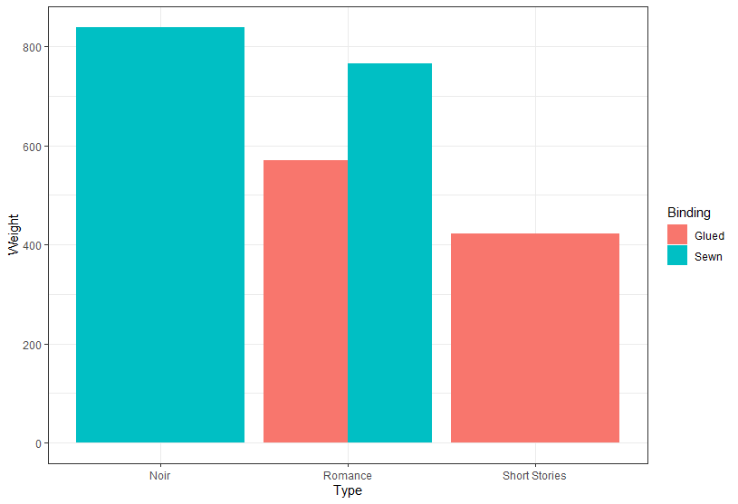
Grouped stacked and percent stacked barcharts
Bar charts are graph that present categorical data with bars with heights or lengths proportional to the values that they represent.
The bars can be plotted vertically or horizontally
Variables Needed
1 or 2 categotical variables for x and color
Y axis
Continuous variable
Use count of a Categorical variable
www.cdcs.ed.ac.uk

Slide 23
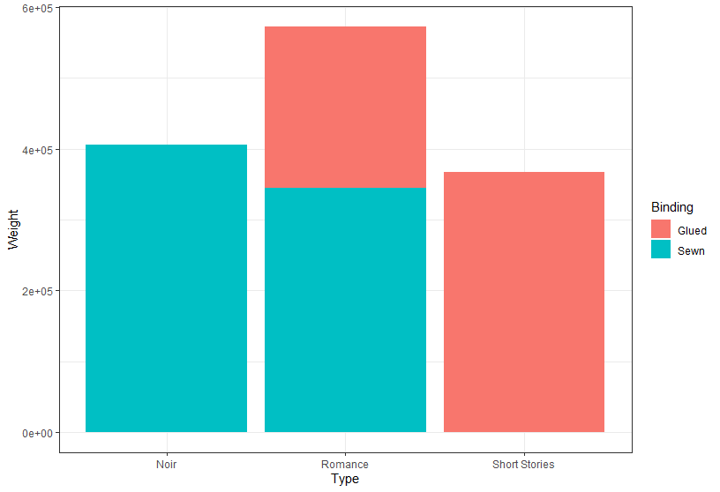
stacked barcharts
Stacked Barplot
ggplot(BooksR, aes(fill=Binding, y=Weight, x=Type)) +
geom_bar(position="Stack", stat="identity")+theme_bw()
www.cdcs.ed.ac.uk

Slide 24
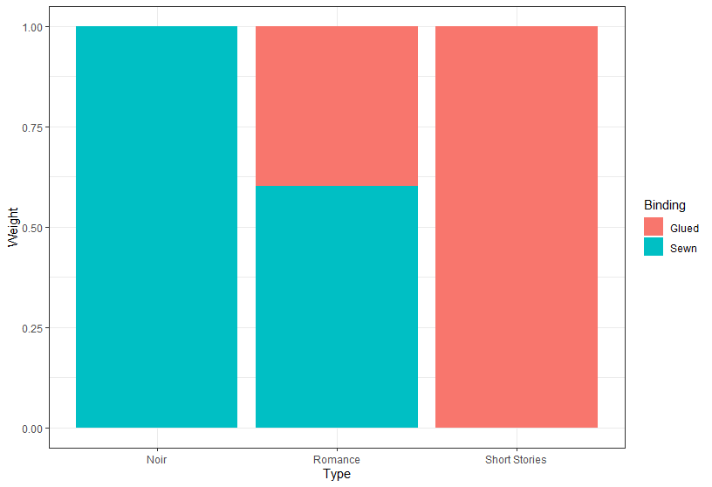
Stacked Barplot using percentage
Use the percentage of the continuous variable
ggplot(BooksR, aes(fill=Binding, y=Weight, x=Type)) +
geom_bar(position="fill", stat="identity")+theme_bw()
www.cdcs.ed.ac.uk

Slide 25
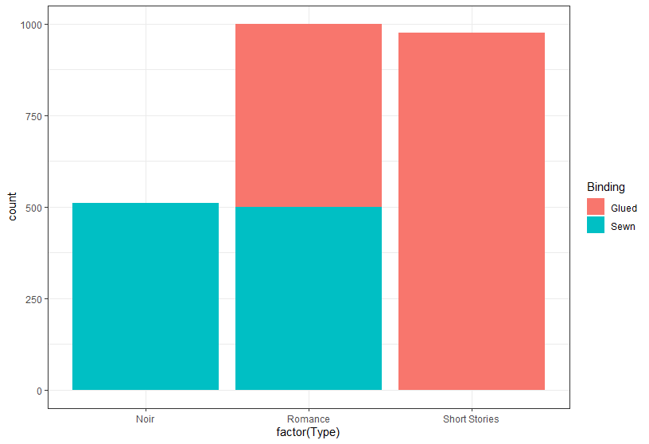
Stacked Barplot using count categorical variable
Use the count of the «Type» observations
ggplot(BooksR, aes(x=factor(Type), fill=Binding)) +
geom_bar()+theme_bw()
www.cdcs.ed.ac.uk

Slide 26
Grouped, stacked and percent stacked barcharts
Bar charts are graph that present categorical data with bars with heights or lengths proportional to the values that they represent.
The bars can be plotted vertically or horizontally
Variables Needed
1 or 2 categotical variables for x and color
Y axis
Continuous variable
Use count of a Categorical variable
www.cdcs.ed.ac.uk

Slide 27
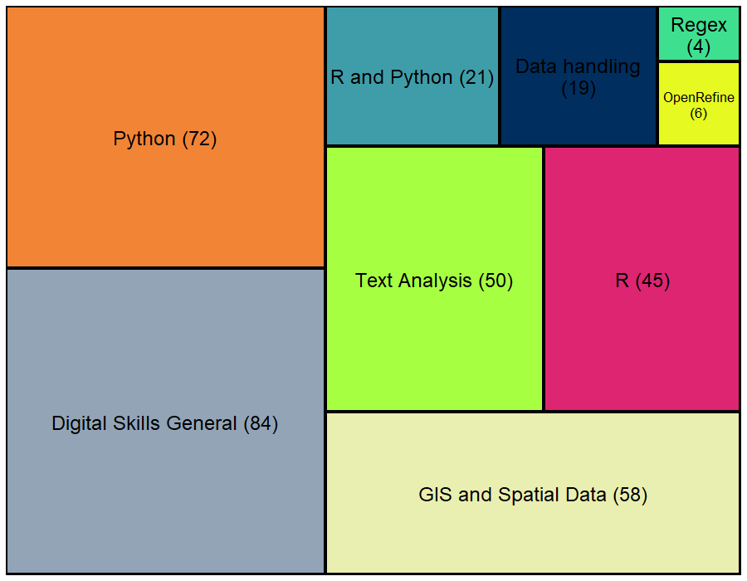
Treemap
Humans are pretty bad at reading angles
Similar percentage slices would be virtually impossible to distinguish
www.cdcs.ed.ac.uk

Slide 28
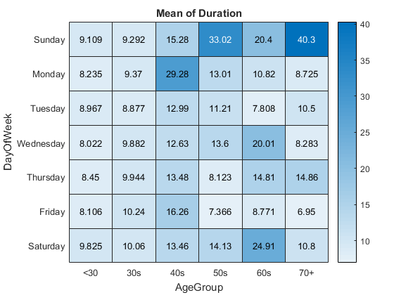
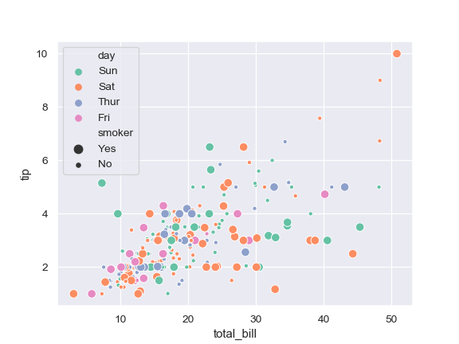
relations
Scatter plot
Heatmap
www.cdcs.ed.ac.uk

Slide 29
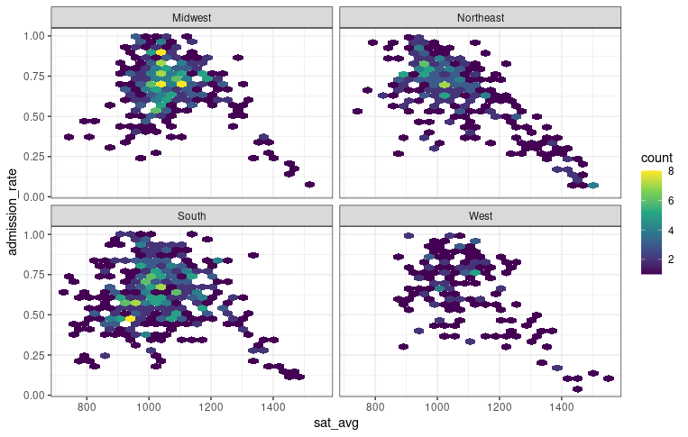
hExbin scatterplot
ggplot(college, aes(x=sat_avg, y=admission_rate) ) + geom_hex(bins = 25) + scale_fill_continuous(type = "viridis") + theme_bw()+
facet_wrap(~region)
www.cdcs.ed.ac.uk

Slide 30
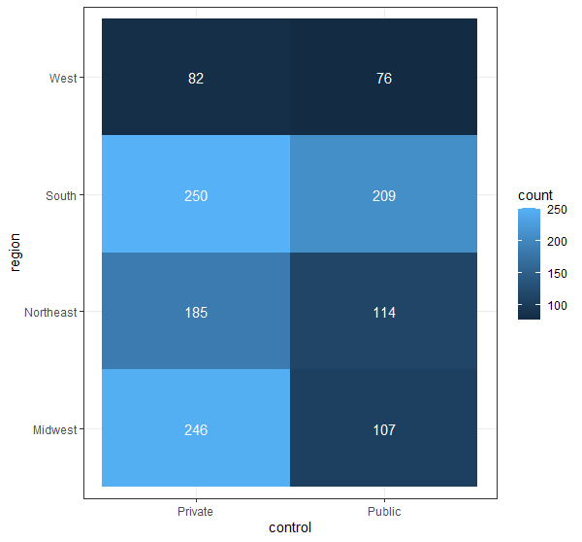
HEATMAP
ggplot(college, aes(x=control, y=region))+ geom_bin2d() +theme_bw()
www.cdcs.ed.ac.uk

Slide 31

Custumize your Graphs
www.cdcs.ed.ac.uk

Slide 32
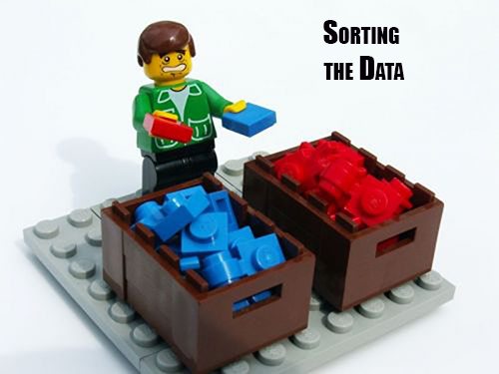
ORDER THE RESULTS
On the fly
Add to the plot
+ scale_x_discrete(limits=c("Romance", "Short Stories", "Noir"))
In the order you want them visualised
From https://blogjunkie.net/2016/01/fastmail-rules-newsletters-contact-groups/data-sorting-lego/
www.cdcs.ed.ac.uk

Slide 33
ORDER THE RESULTS
Change the dataset
From https://blogjunkie.net/2016/01/fastmail-rules-newsletters-contact-groups/data-sorting-lego/
Make sure the variable is set as factor:
newBooks <- BooksR %>% mutate(Type = as.factor(Type))
newBooks %>%
pull(Type) %>%
levels()
Define the new order
newBooks$Type <- factor(newBooks$Type, levels(newBooks$Type)[c(2,3,1)])
In the order you want them visualised
www.cdcs.ed.ac.uk

Slide 34
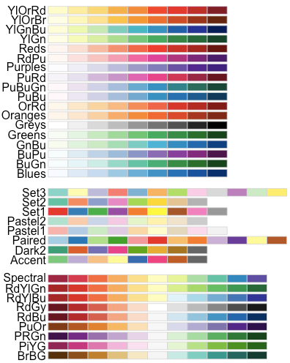
colour
Color brewer Palettes
https://www.datanovia.com/en/blog/top-r-color-palettes-to-know-for-great-data-visualization/
www.cdcs.ed.ac.uk

Slide 35
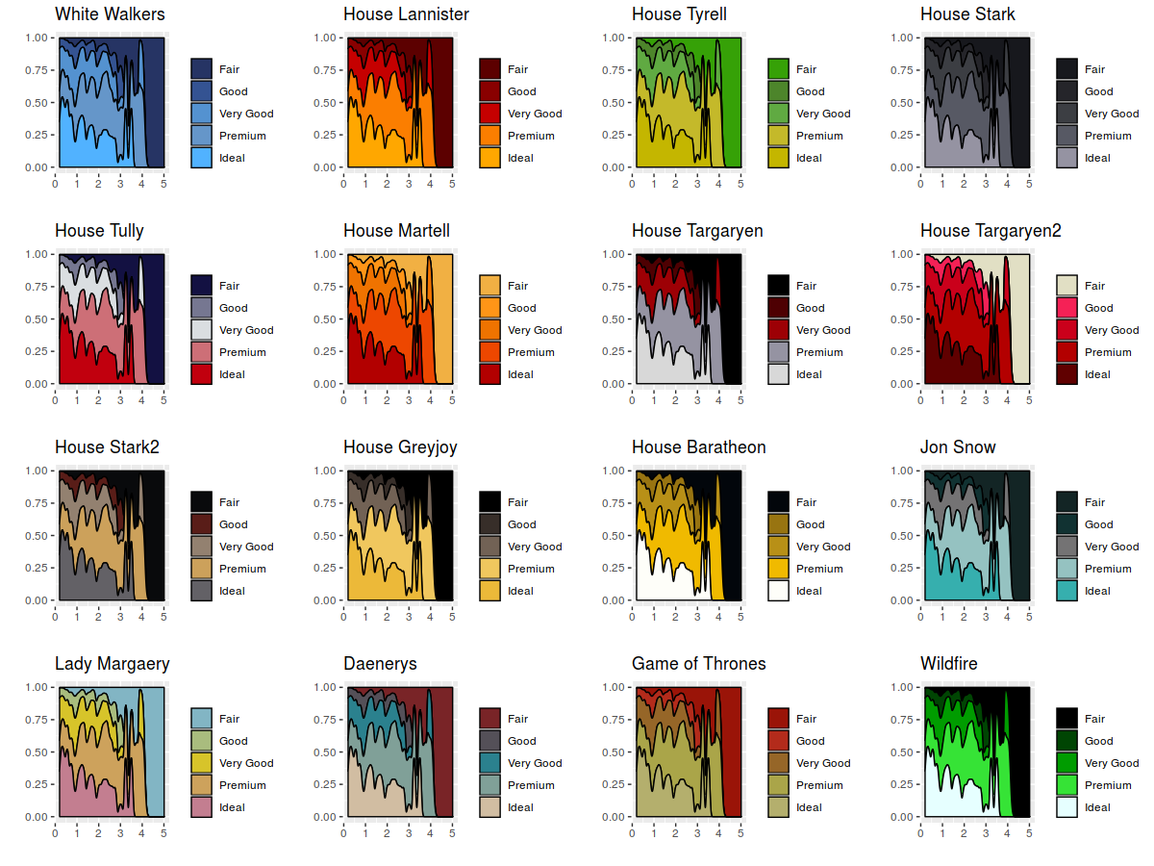
colour
Games of Thrones Palette
https://github.com/aljrico/gameofthrones
www.cdcs.ed.ac.uk

Slide 36
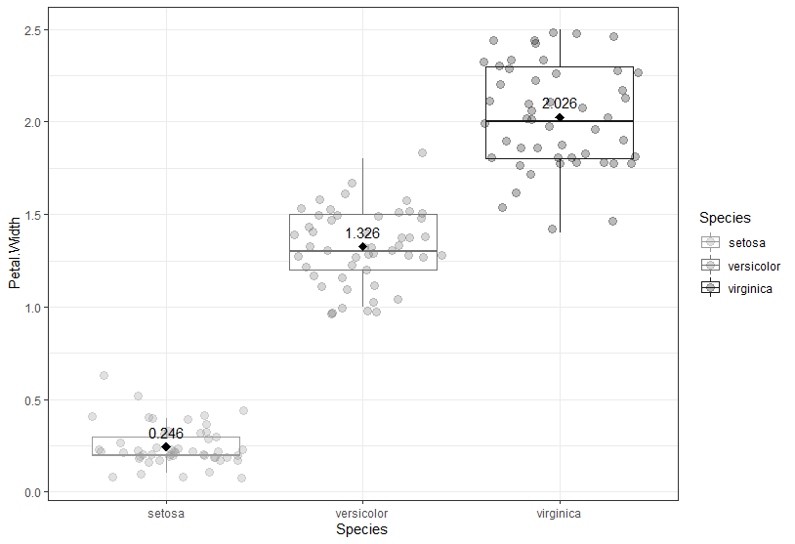
Colour- gray palette
You can plot everything in a gray scale by using
+ scale_color_grey(start = 0.6, end = 0.1)
Start: the lighter value
End: the darker color
www.cdcs.ed.ac.uk

Slide 37
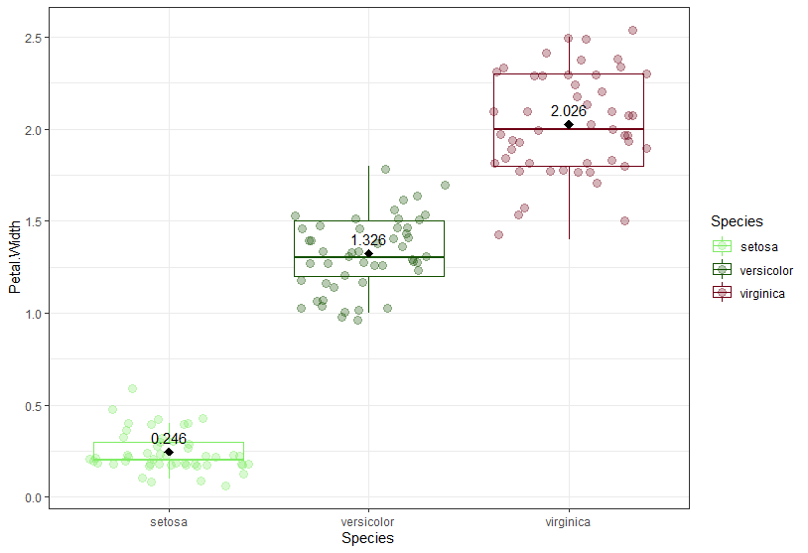
Colour- manually change colours
You can use either the hex values (https://www.hexcolortool.com/)
or the colours names recognised by ggplot (http://sape.inf.usi.ch/quick-reference/ggplot2/colour)
You need to select a n number of colors corresponding to the number of different colours you need within a concatenate function (c)
www.cdcs.ed.ac.uk

Slide 38
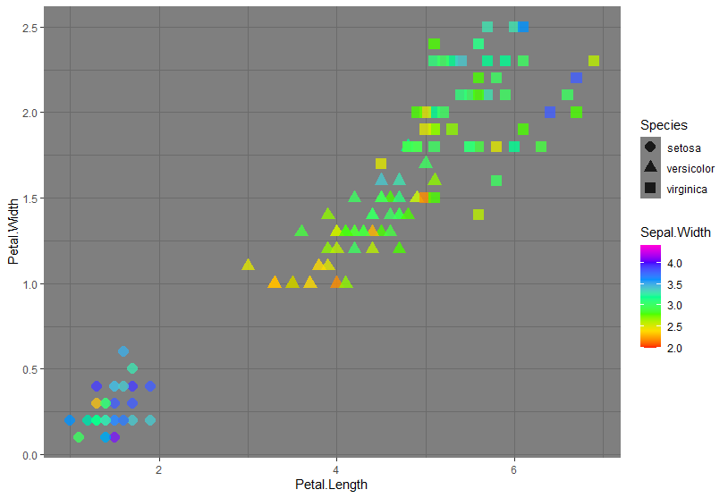
Colour- continuous colours
When instead of a series of values you need a continous palette like for scatterplots you can use:
+scale_color_gradientn(colours = rainbow(7))
7: is the number of colours the system will use and rainbow is the palette
www.cdcs.ed.ac.uk

Slide 39

Remove null values
In order to perform any type of analysis on your sample you need to eliminate the Null values.
Two approaches possible
Eliminate all rows that has a null value for any of the variable: 1 Step analysis
Eliminate rows based on the single analysis performed: Doesn’t eliminate what is not needed but need more attention on number observations
www.cdcs.ed.ac.uk

Slide 40
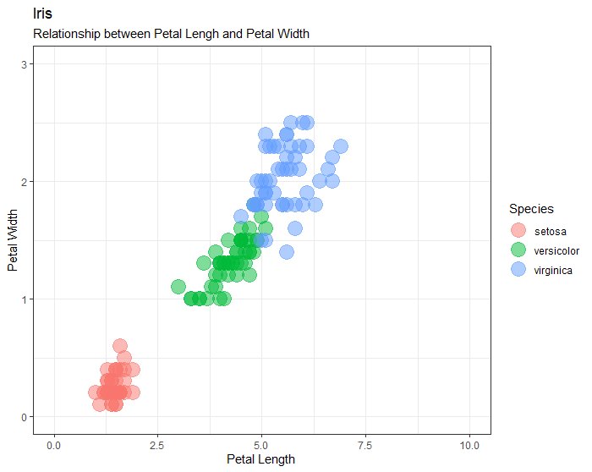
Change Scale Axis
Define limit axis
Add
+expand_limits(x=c(0,10), y=c(0, 3))
Min and Max values
www.cdcs.ed.ac.uk

Slide 41
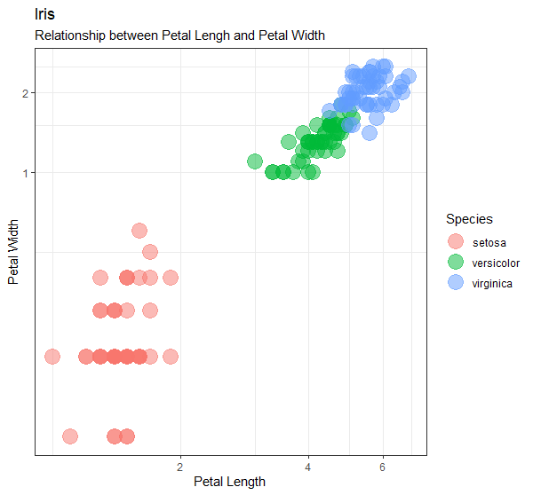
Change Scale Axis
Use logarithmic scale
Add
+ coord_trans(x="log", y="log")
Log is natural logarithm. Also available log10 and log2
www.cdcs.ed.ac.uk

Slide 42
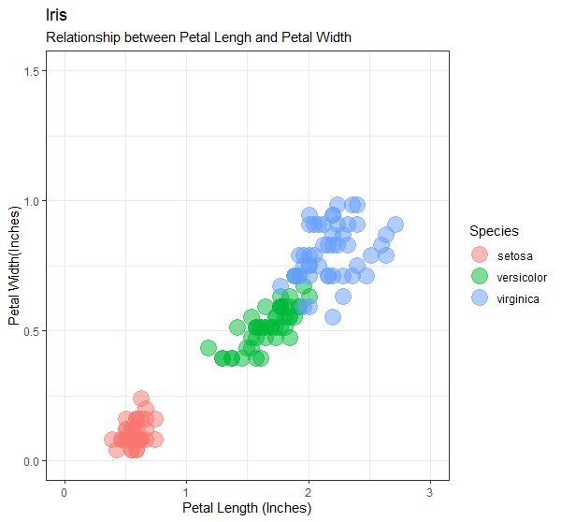
Change Scale Axis
ggplot(iris, aes(x=Petal.Length/2.54, y=Petal.Width/2.54, color=Species)) + geom_point(size=6, alpha=0.5)+theme_bw()+ labs(title = "Iris", subtitle = "Relationship between Petal Lengh and Petal Width", x = "Petal Length (Inches)", y= "Petal Width(Inches)")
Calculate a on the fly equivalence
Make sure to reflect it in the legend
www.cdcs.ed.ac.uk

Slide 43
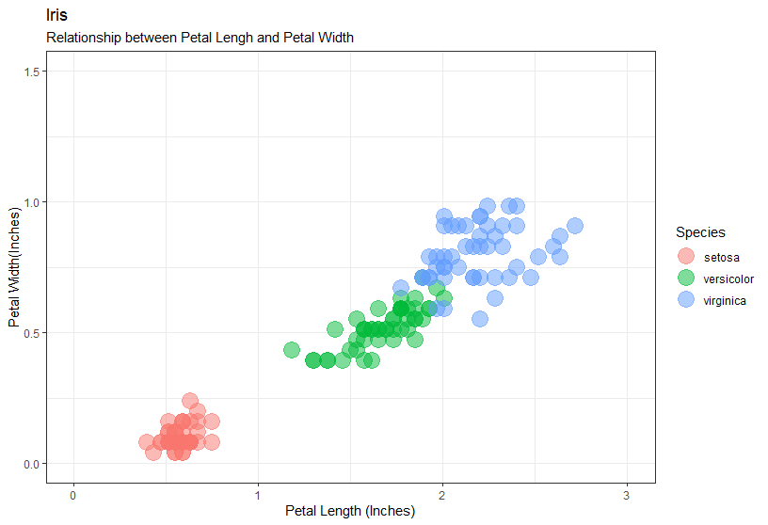
SET thicks of the grid
Smaller grid no visible number
Add
+ scale_x_continuous(minor_breaks = seq(0,3, 0.5),
breaks = seq(0,3,1))+
scale_y_continuous(minor_breaks = seq(0,2, 0.25), breaks = seq(0,2,0.5))
Major grid visible number
Seq(start, max, every how many)
www.cdcs.ed.ac.uk

Slide 44
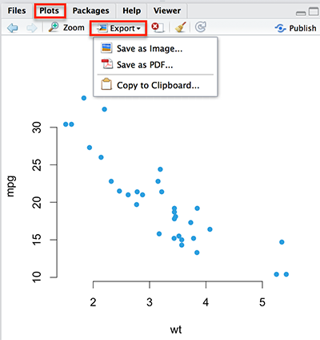
Export your graphs
ggsave(filename='Figure1.tiff', dpi=600, path='Graph')
How I want to call it
How big
Where I am saving
www.cdcs.ed.ac.uk

